Slide 1

KBC GAME
Prepared by:
Sanjay kumar praween rajwanshi
2016ucp1382 2016ucp1401

Slide 2
1.INTRODUCTION
1.1. Project Overview
This web application provide facility to user to play online KBC GAME.
This application allows user to play the game and check their prize after the game ended.
Admin can Manage the user . Admin can add more question to the game at any time.
New users can register themselves on the portal and take the part in game .

Slide 3
1.2. Purpose
To improve the knowledge of user .
Responses by the candidates will be checked automatically and instantly.
Made for fun.
User can check their results just after the game is ended.

Slide 4
1.3. Rule for game
You have 30 Second of Answering Questions from 1 to 7 .
You have 1 Minute of Answering Questions from 8 to 13 .
After the timeout or give the wrong answer, you have to Quit the Game.
You can use Life Line for Help.
If you are not sure you can QUIT the game in between.
If you give the wrong answer OR timeout You will get Half of won prize and if you quit the game you will get full of won prize.
If you give correct answer of all question then you will win.

Slide 5
2. Functional or Specific requirements : This web application is for online KBC GAME Administrator and User should satisfy following requirements:
Administrator:
Logging into the system.
Editing of database.
Manage the user.
Manage the questions.
User:
Registration on the portal.
Logging into the system.
Playing the kbc game.
Printing the prize won at the end of the game.
Reviewing the questions in the quiz.

Slide 6
2.1. Technologies required : These are the technologies for this application. 1. HTML, CSS and Basic JavaScript for the front end. 2. PHP and MySQL for the back end.
2.2. Software
1. notepad++ for editing and coding.
2. Apache XAMPP as web server.

Slide 7
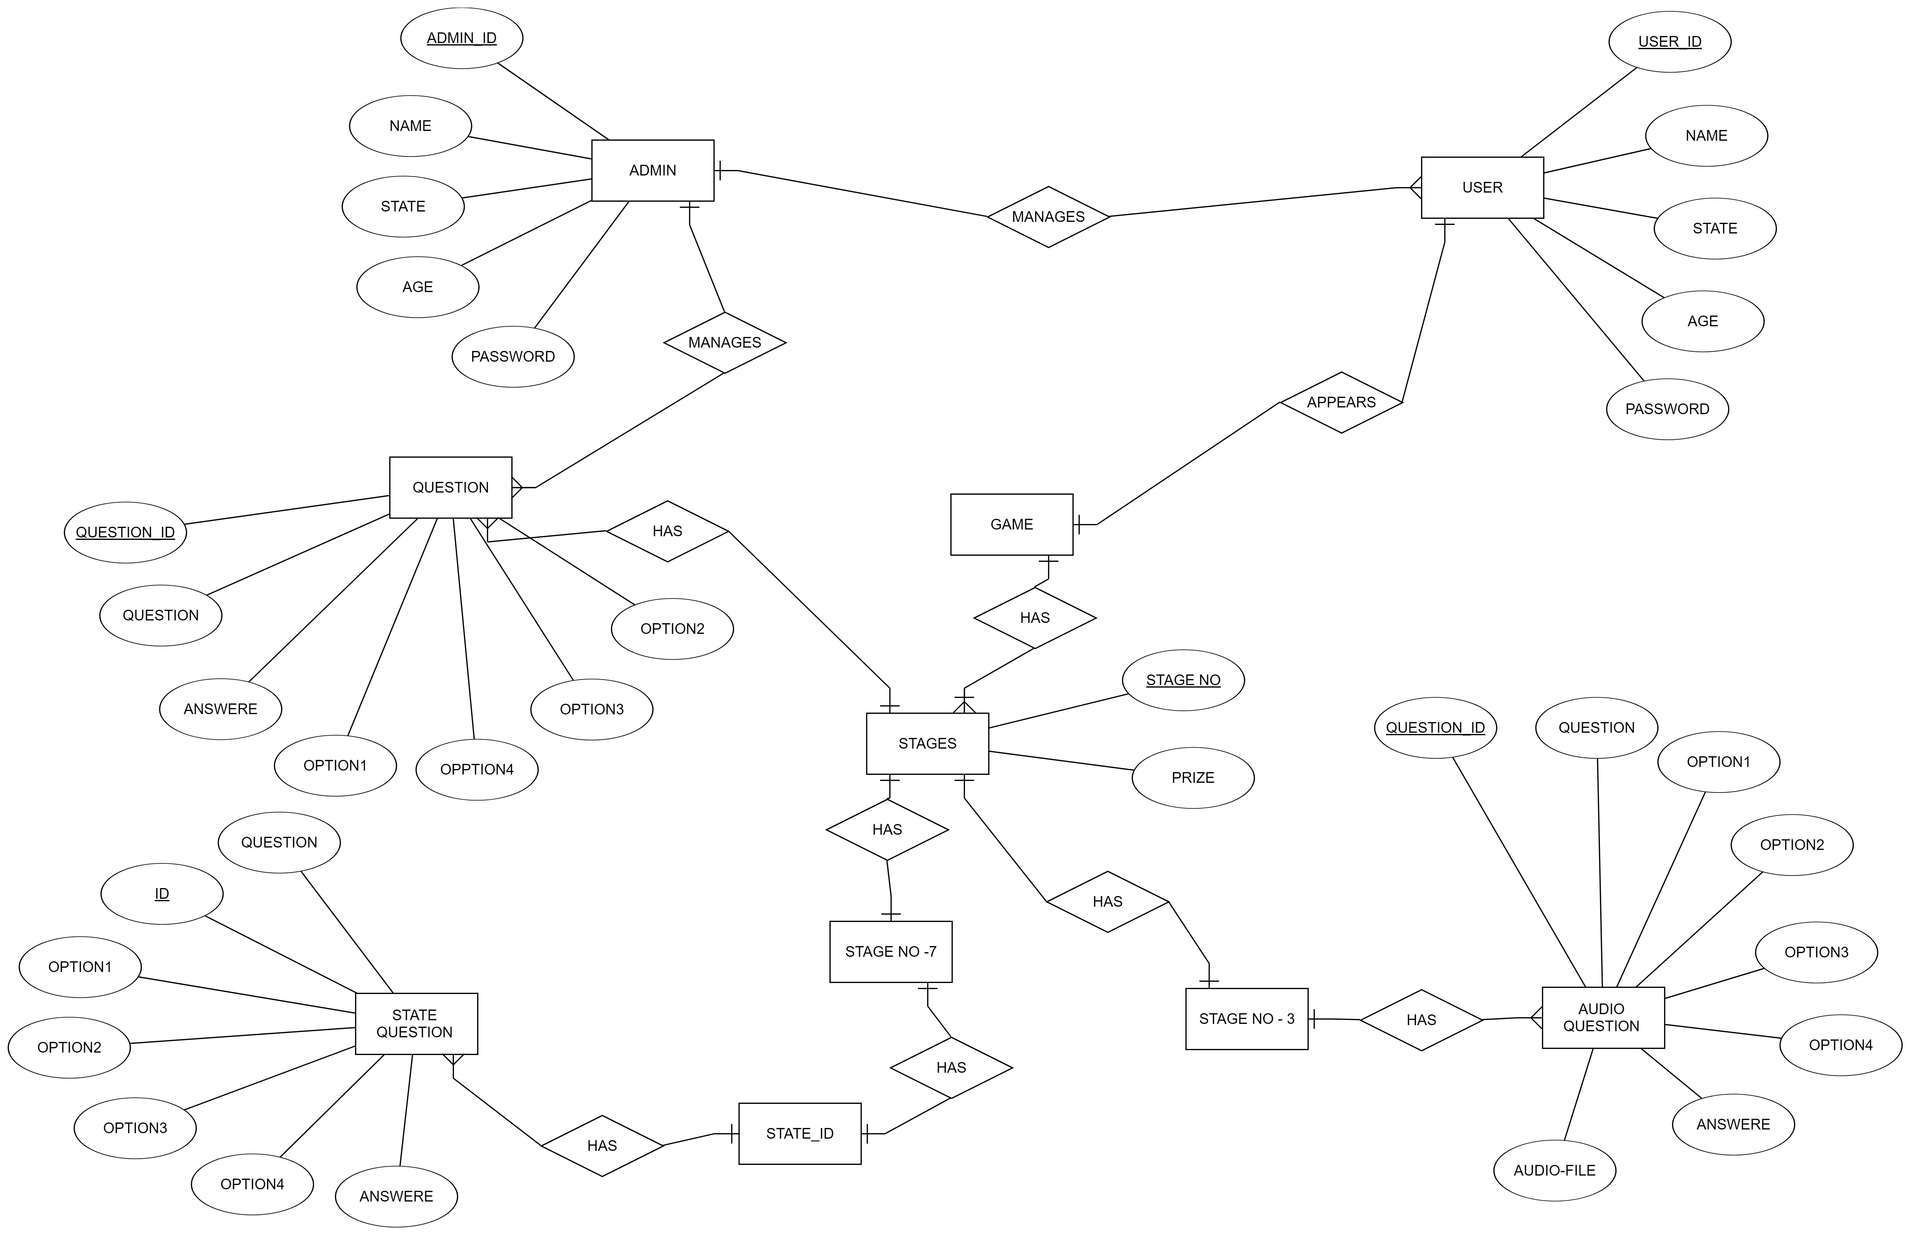
3. Design: 3.1. ER Diagram:

Slide 8
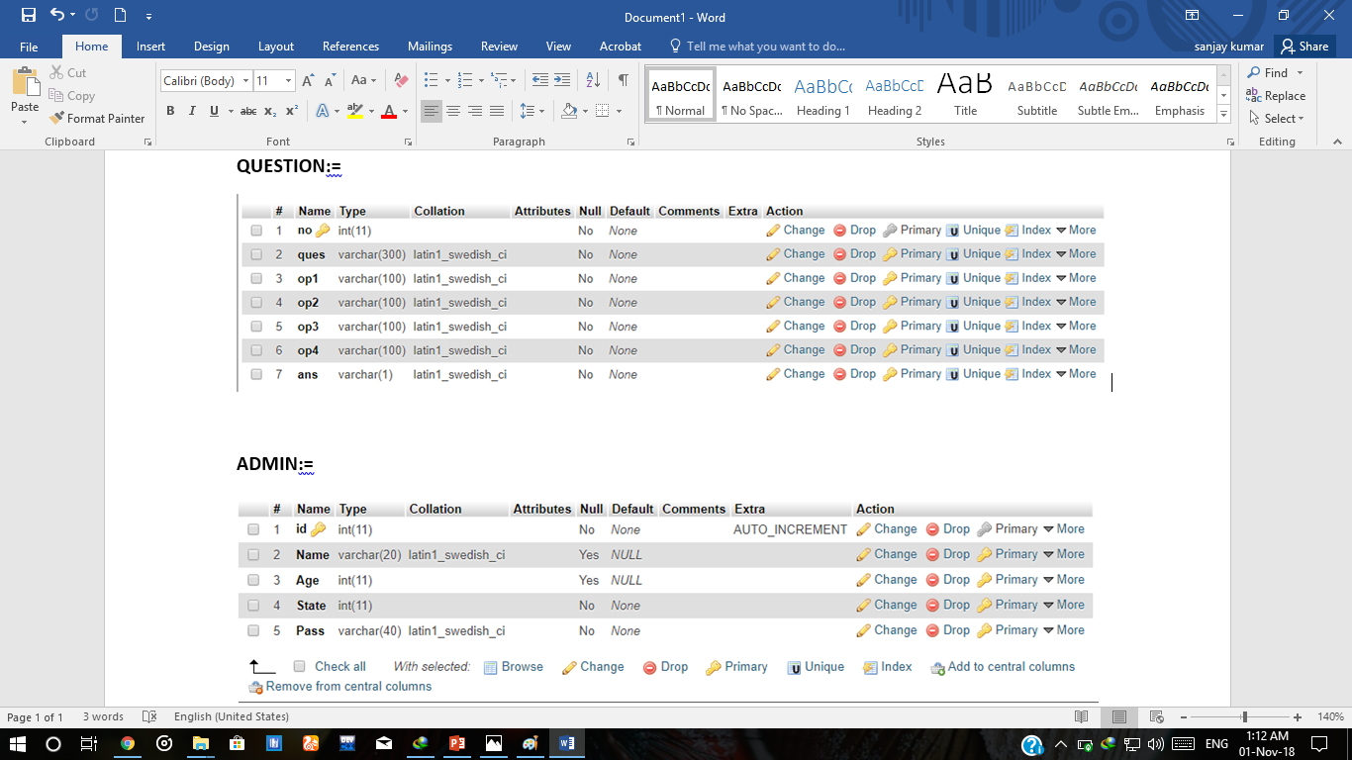
3.2 Database Schema :

Slide 9
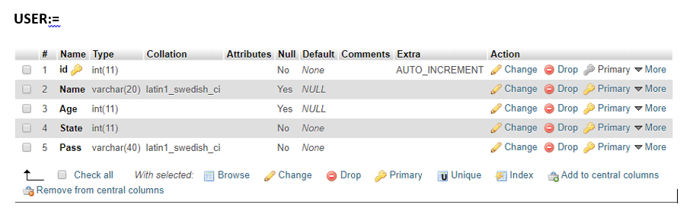
3.2 Database Schema :

Slide 10
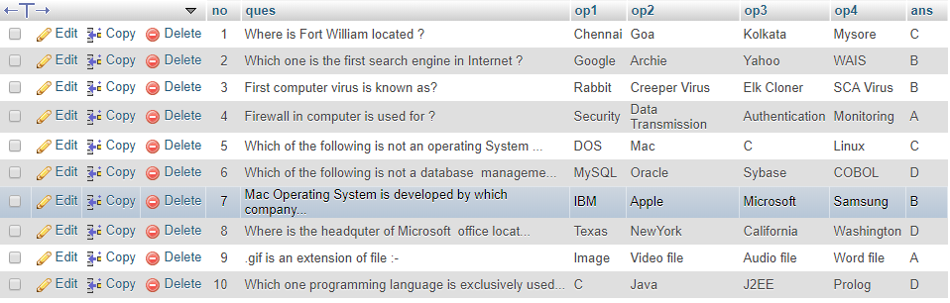
3.3.Tables
Table: QUESTION

Slide 11
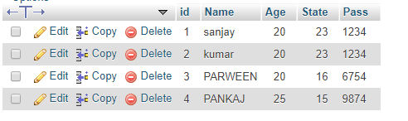
Table: ADMIN

Slide 12
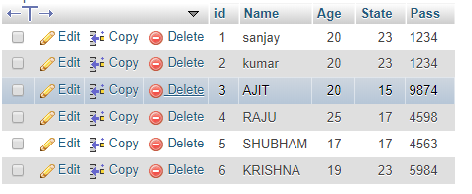
Table : USER

Slide 13
Normalization of tables:
1. admin:
id -> {pass,name,age,state}
candidate key = id
There is only one FD so table is normalized upto BCNF.
2. user:
id -> {pass,name,age,state}
candidate key = id
There is only one FD so table is normalized upto BCNF.

Slide 14
3. question:
id -> { question, option1, option2, option3, option4, ans}
candidate key = id
There is only one FD so table is normalized upto BCNF.

Slide 15
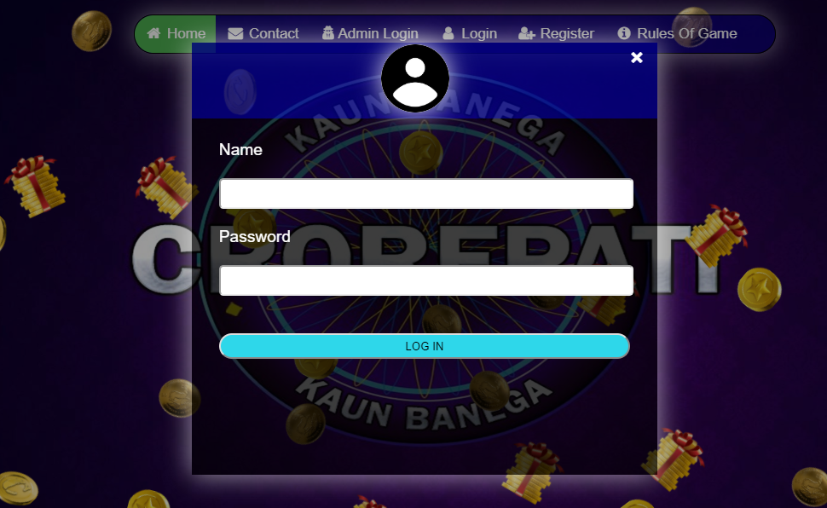
4. User Interfaces:
1.Login interface:

Slide 16

2. Home page:

Slide 17
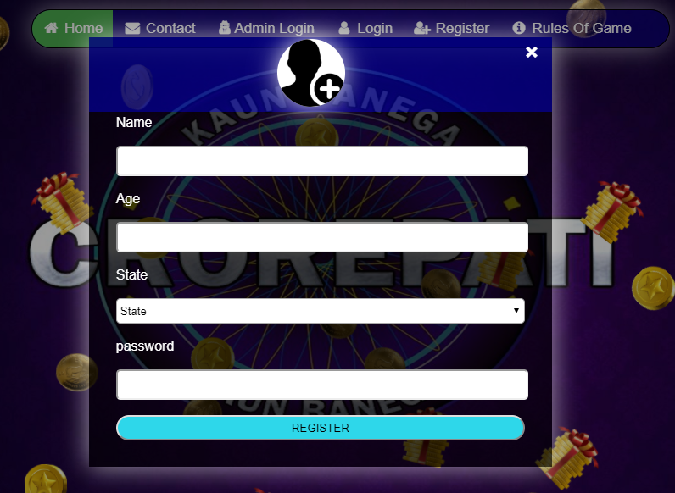
3.Add new user :

Slide 18
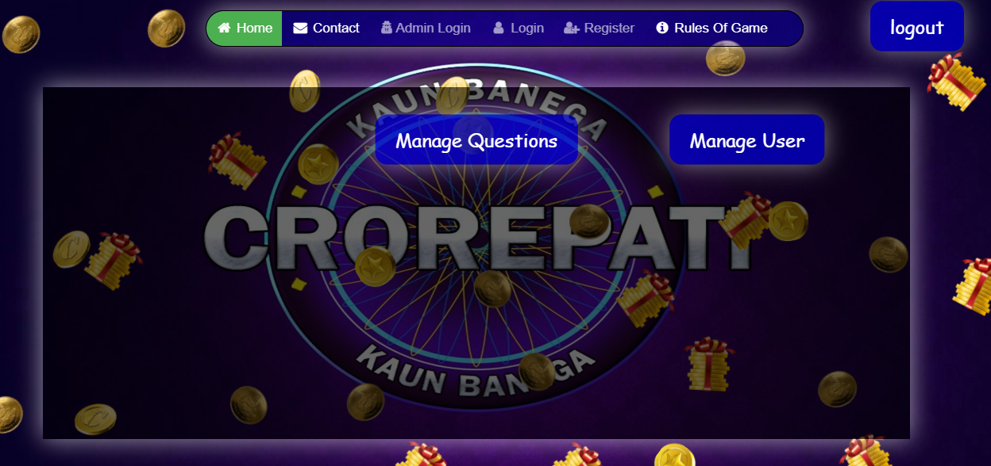
4.Admin Home page:

Slide 19
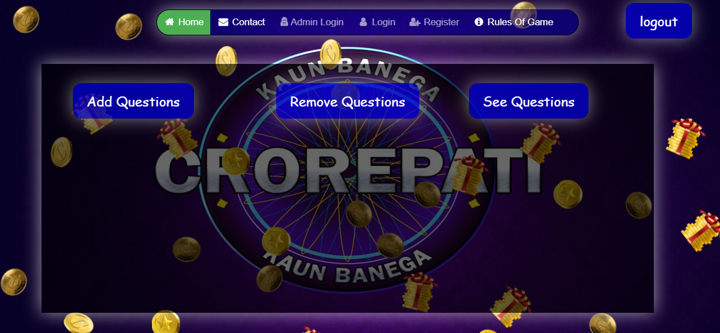
5.Manage Question(admin):

Slide 20
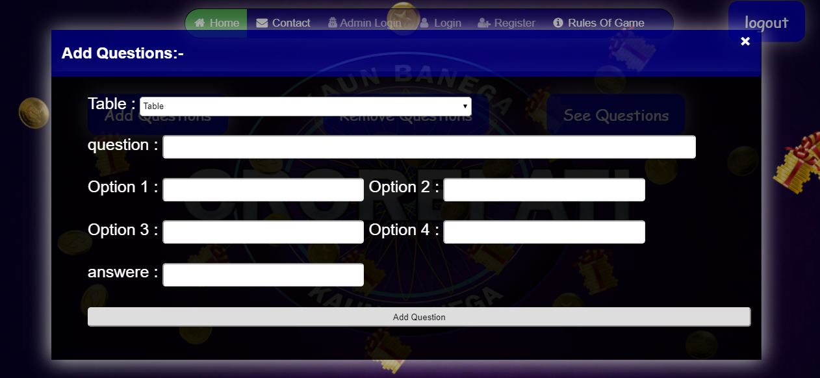
6.Add Question(admin):

Slide 21
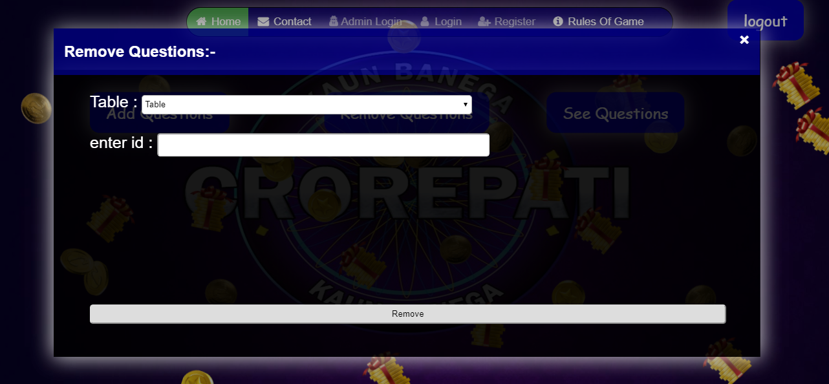
7.Remove Question(admin):

Slide 22
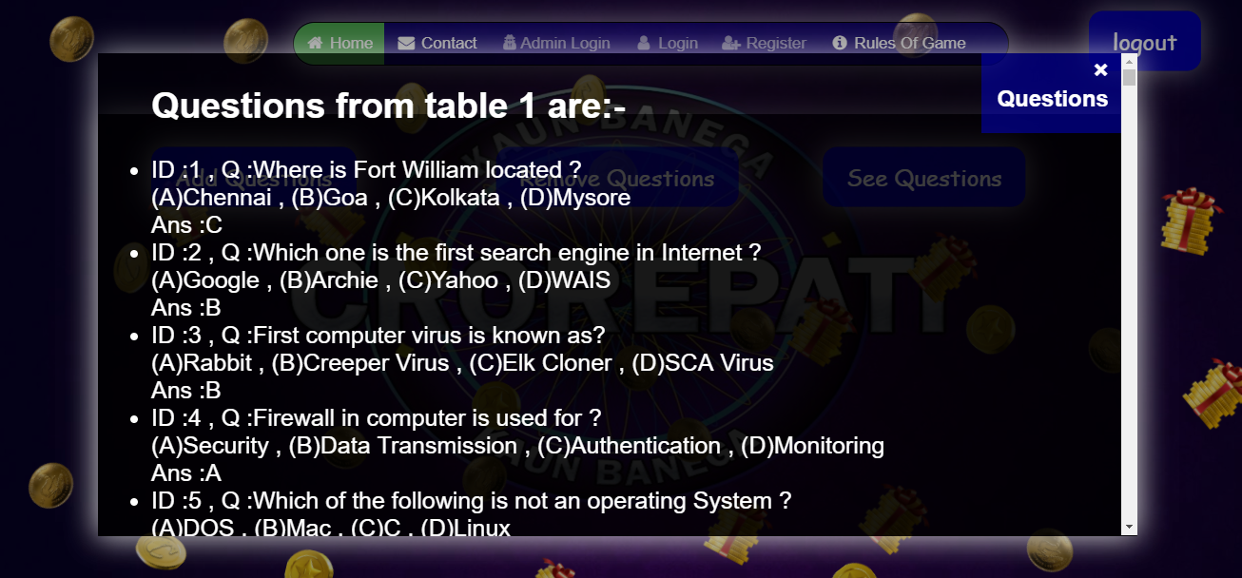
8.See Question(admin):

Slide 23
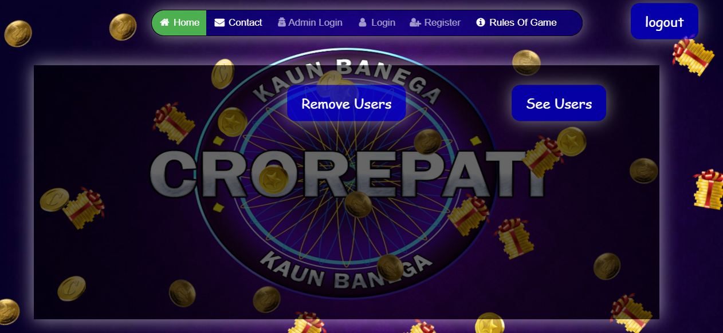
9.Manage Users(admin):

Slide 24
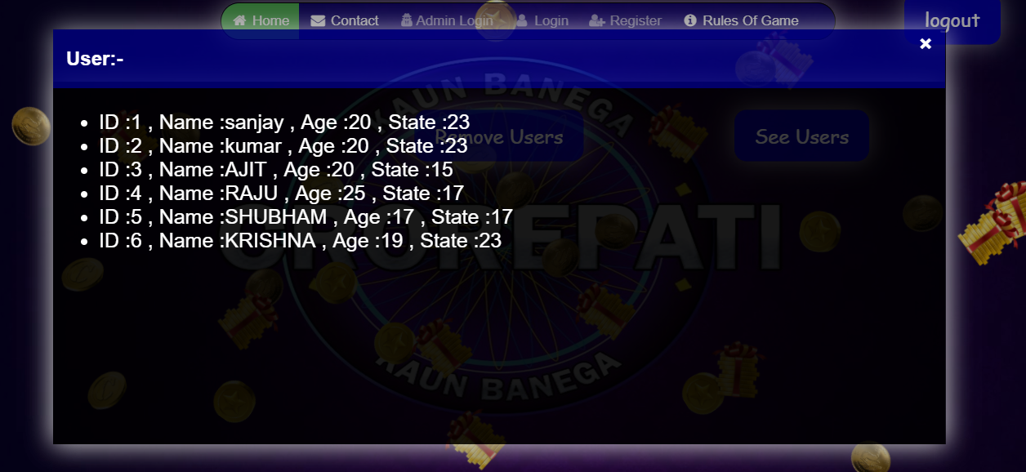
10.See Users(admin):

Slide 25
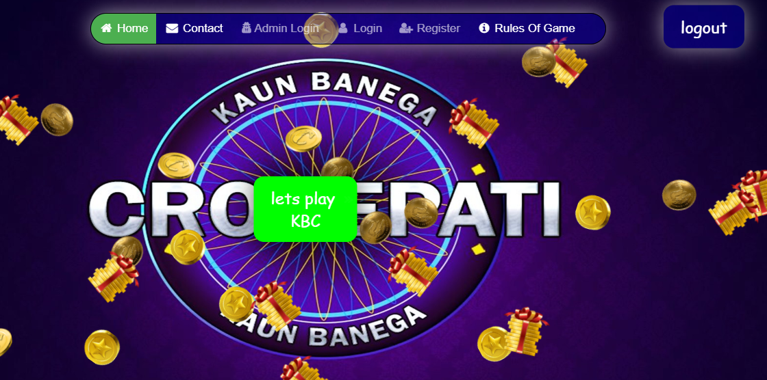
11.User home page:

Slide 26
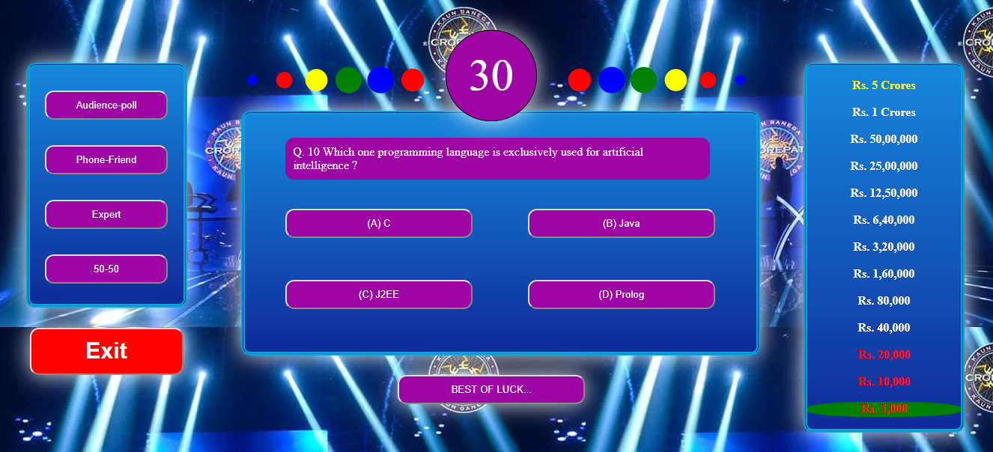
12.Quiz questions :

Slide 27
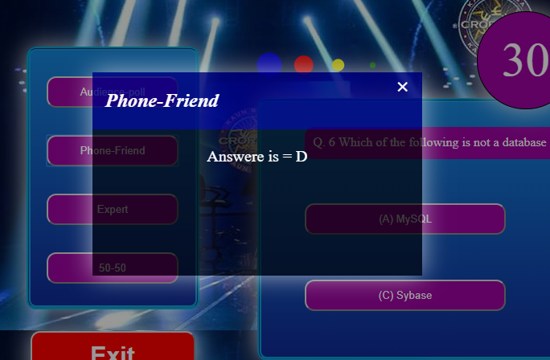
13.Lifeline :

Slide 28
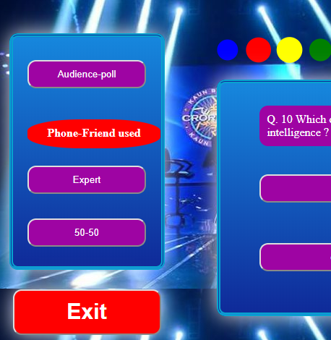
14.Lifeline(used) :

Slide 29
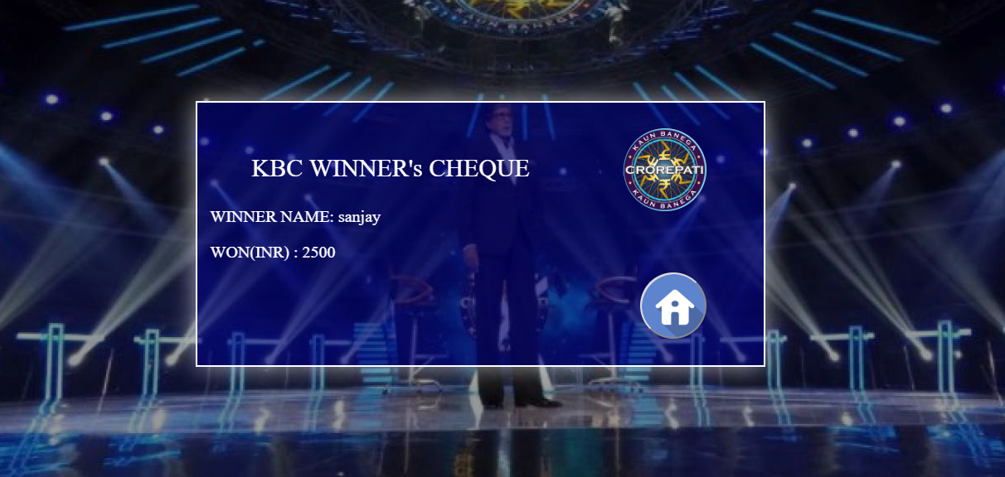
15.prize :

